Slide 1
Storytelling Case Study: Airbnb, NYC
By: Ashutosh Francis
Tanzeel Iqbal &
Vedant Patil

Slide 2
Agenda:
Objective
History
Data Preparation
Key Insights with Visualisation
Inferences from case study

Slide 3
Objective:
Airbnb is an online platform used by people to rent their unused accommodations.
During the covid pandemic time, Airbnb had incurred a huge loss in the revenue.
Now people have started travelling again and Airbnb want to rise the business again and ready to serve to customers.

Slide 4
History:
For the past few months, Airbnb has seen a major decline in revenue.
Now that the restrictions are reduced and people started travelling more, Airbnb wants to prepare itself for this change.
So an analysis is done on a dataset consisting of various Airbnb listings in New York.

Slide 5
Data Preparation:
Understood the dataset
Cleaned data to remove any missing values and duplicates if present in the dataset.
Dropped columns which are insignificant.
Identified outliers present in the dataset

Slide 6
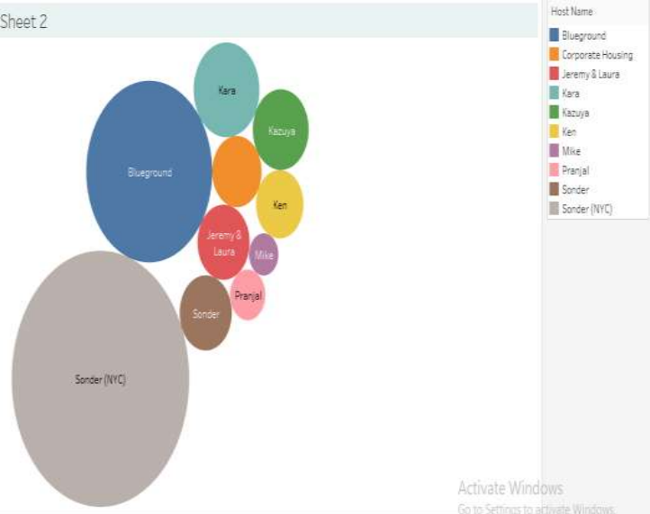
Top 10 Hosts:
We can see that Host Sonder(NYC) is booked most number of times.
Host Blue ground is the 2nd popular host.
Then there are other hosts like Kara, Ken, Pranjal, Jeremy and Mike that fall under top 10 hosts.

Slide 7
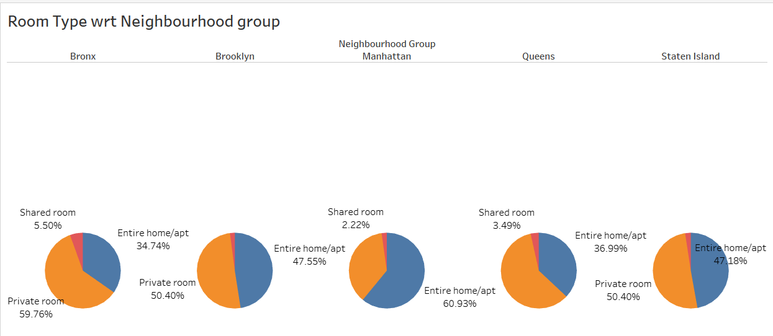
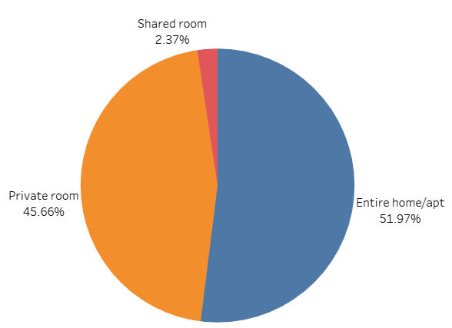
Room type with respect to
Neighbourhood group:
Here 3 types of rooms are there - Entire home/Apartment, Private room & shared room.
Customers prefer private rooms (45%) or entire homes (52%) in comparison to shared rooms (2.4%).
Airbnb can focus on the promotion of shared rooms with discounts to increase bookings and also get more private listings.
Queens & Bronx contribute 60% each to private rooms, more than the combined ratio of 45% Whereas, Manhattan has more contribution in entire home (61%), compared to the combined ratio of 52%.

Slide 8
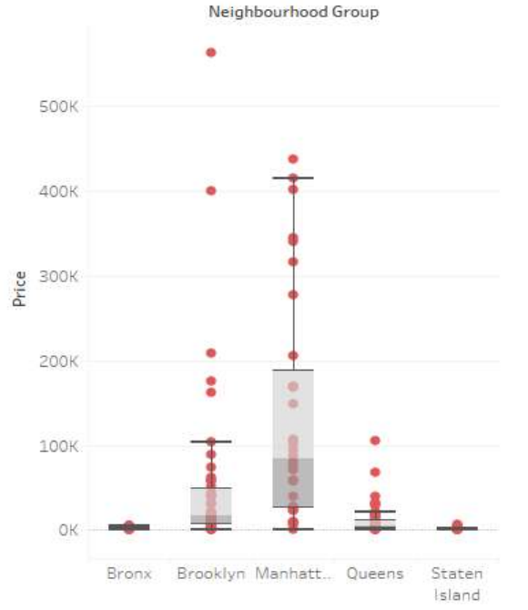
Price Analysis
Neighborhood wise:
We can see that most of the outliers in Price column are present in Brooklyn and Manhattan.
Manhattan has the highest range of prices for the listings.
Bronx is the cheapest among all.
We can see the median price of all neighbourhood groups is lying between $ 80 to $ 300.
We can see that price was positively skewed, so median was very close to the lower quartile with some outliers as seen in the boxplot.

Slide 9
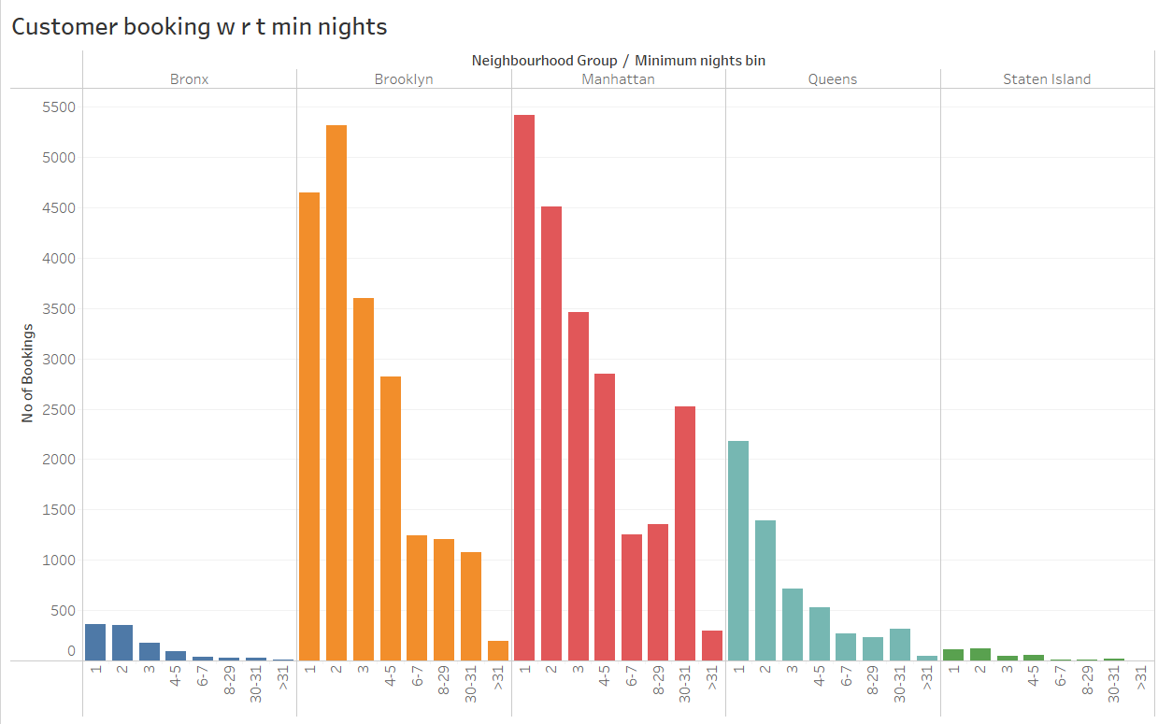
Customer Booking with respect to minimum nights:
Listings with Minimum nights 1-5 have the most number of bookings. A good spike can be seen in 30 days, this will be because customers would rent out on a monthly basis.
We can also see small spikes after 30 days, this can also be observed by the monthly rent taking trend.
Manhattan &Queens have larger number of 30 day bookings compared to the others. The reason can be either long stay bookings of tourists or mid-level employees who opt for budget bookings due company visits.

Slide 10
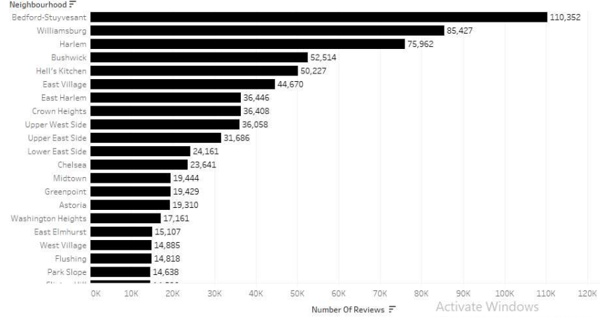
Popular Neighbourhood:
Bedford-Stuyvesant from Brooklyn is the most popular with 1,10,352 reviews in total and Williamsburg follows it.
Harlem from Manhattan has the highest no. of reviews followed by Hell’s kitchen.
The higher number of customer reviews shows higher satisfaction in these localities.

Slide 11
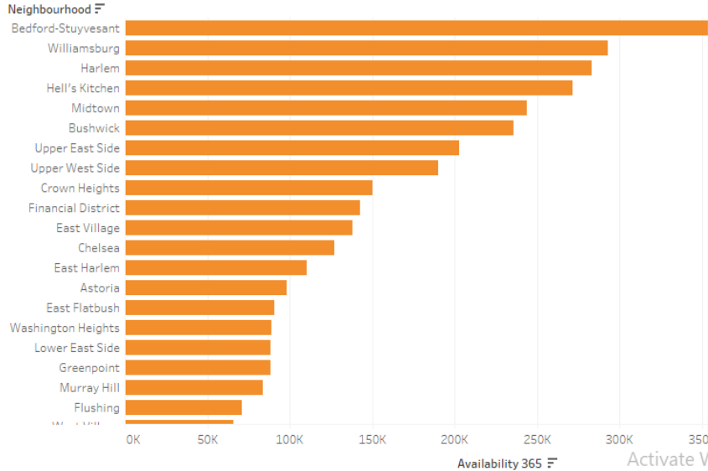
Neighbourhood Vs Availability:
Availability of Bedford is highest and also its price is lower. It is definitely a good choice for customers.
We can see that after Bedford, Harlem follows the trend.
Chelsea’s availability is low but it is costlier.
On the other hand, William’s has average availability but price is high.

Slide 12
Inferences from the case study:
We have observed that people like to visit the center of New York, where the beauty of the city can be seen.
The Entire Room or apartment is most listed room type & customers prefers it mostly , while exactly opposite is true for shared room.
Manhattan & brooklyn are costliest neighborhood group, but still customers prefer them.
We can focus on the locations that are present in Manhatten and Brooklyn because these are most famous prime locations as people shows interest in it.

Slide 13
Thank You

